Slide 1

YAY! - Celebrating Education

Slide 2
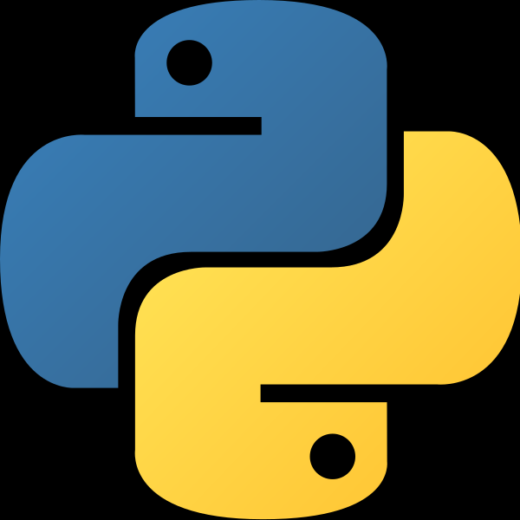

Python Course
(Basics)

Slide 3
Functions in Python

Slide 4
Course Agenda for Today
Python Arguments
Python Arbitrary Arguments
Recursion
What are Python Built-In Functions?
Python Zip Function
Python Iterators
Python Lambda Functions

Slide 5
Python Arguments
Information can be passed into functions as arguments.
Arguments are specified after the function name, inside the parentheses. You can add as many arguments as you want, just separate them with a comma.
The terms parameter and argument can be used for the same thing: information that are passed into a function.
By default, a function must be called with the correct number of arguments. Meaning that if your function expects 2 arguments, you have to call the function with 2 arguments, not more, and not less.
def my_function(fname, lname): print(fname + " " + lname) my_function(“Jasleen", “Sondhi")

Slide 6
Python Arbitrary Arguments
You may not always know how many arguments you’ll get. In that case, you use an asterisk(*) before an argument name.
def sayhello(*names):
for name in names:
print(f"Hello, {name}“
sayhello('Ayushi','Leo','Megha')
And then when you call the function with a number of arguments, they get wrapped into a Python tuple.

Slide 7
Recursion
Python also accepts function recursion, which means a defined function can call itself.
Recursion is a common mathematical and programming concept. It means that a function calls itself. This has the benefit of meaning that you can loop through data to reach a result.
The developer should be very careful with recursion as it can be quite easy to slip into writing a function which never terminates, or one that uses excess amounts of memory or processor power. However, when written correctly recursion can be a very efficient and mathematically-elegant approach to programming.
Recursion by CS50

Slide 8
What are Python Built-In Functions?
1. abs()
The abs() is one of the most popular Python built-in functions, which returns the absolute value of a number.
2. all()
The all() function takes a container as an argument. This Built in Functions returns True if all values in a python iterable have a Boolean value of True.
An empty value has a Boolean value of False.
3. bin()
bin() converts an integer to a binary string. We have seen this and other functions in our article on Python Numbers.
4. complex()
complex() function creates a complex number. We have seen this is our article on Python Numbers.
More on Built-In Functions in Python

Slide 9
Python Zip Function
In this Python tutorial, we will discuss Python Zip Function. Moreover, we will discuss the built-in zip() function in Python with the example. Also, we will understand Zip in Python and Python Unzipping Values.
The zip() function returns a zip object, which is an iterator of tuples where the first item in each passed iterator is paired together, and then the second item in each passed iterator are paired together etc.
Syntax-
zip(iterator1, iterator2, iterator3 ...)
zip() is a built-in Python function that gives us an iterator of tuples. Let’s take a quick example of Python Zip Function.
for i in zip([1,2,3],['a','b','c']):
print(i)
a = ("John", "Charles", "Mike")
b = ("Jenny", "Christy", "Monica", "Vicky")
x = zip(a, b)

Slide 10
Python Iterators
An iterator is an object that contains a countable number of values.
An iterator is an object that can be iterated upon, meaning that you can traverse through all the values.
Technically, in Python, an iterator is an object which implements the iterator protocol, which consist of the methods __iter__() and __next__().
Lists, tuples, dictionaries, and sets are all iterable objects. They are iterable containers which you can get an iterator from.
All these objects have a iter() method which is used to get an iterator.
mytuple = ("apple", "banana", "cherry")
myit = iter(mytuple)
print(next(myit))
print(next(myit))
print(next(myit))

Slide 11
Python Lambda Functions
A lambda function is a small anonymous function.
A lambda function can take any number of arguments, but can only have one expression.
Syntax-
lambda arguments : expression
x = lambda a : a + 10 print(x(5))
Lambda functions can take any number of arguments:
x = lambda a, b : a * b print(x(5, 6))

Slide 12
Why Use Lambda Functions?
The power of lambda is better shown when you use them as an anonymous function inside another function.
def myfunc(n): return lambda a : a * n

Slide 13
Thank You!
See you in the next class!

